Slide 1

Dynamical control of single leg using Physics Informed AI
By:
Shivansh Pandey
Supervisor:
Professor Shakti S. Gupta

Slide 2
Literature review

Slide 3
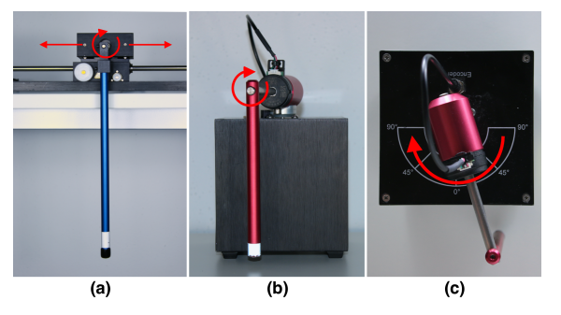
Cartpole and Furuta control using DeLan 4EC
Deep lagrangian networks with energy control
Lutter, M., Listmann, K., & Peters, J. (n.d.). control for under-actuated systems.

Slide 4
DeLan 4EC vs system identification
DeLaN is capable of learning the underlying ODE and energies from data using the joint configurations and motor torques.
DeLaN learns the mass-matrix, the centrifugal, Coriolis, gravitational and frictional forces as well as the potential and kinetic energy using unsupervised learning.
Knowledge of the kinematic structure is not needed

Slide 5
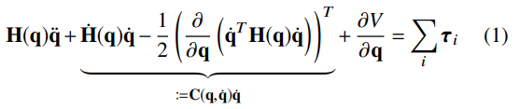
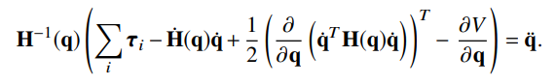
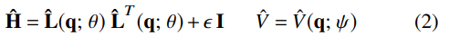
Forward model -
Inverse model-
H is mass matrix simplified as-
(L is lower triangular matrix)
Online Learning:
The network parameters can be learned online and end-to-end, by minimizing the error of the ODE using the samples {q, qÛ, qÜ, τ M } recorded on the physical system, i.e. minimizing the li norm between the prediction of Equation 1 and the observed motor torque τ M . Therefore, the superposition of the different forces is learned supervised, while the decomposition into inertial, Coriolis, centripetal and gravitational forces is learned unsupervised.

Slide 6
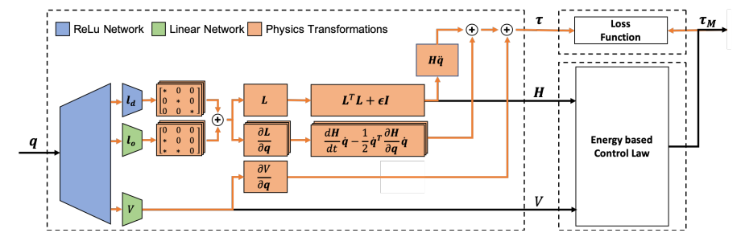
Things DeLan 4EC does
Adheres to the Lagrangian Mechanics
Ensures energy conservation

Slide 7
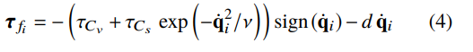
Incorporating friction
Friction coefficients-
Since the frictional force τ f is a function of the generalized coordinates, the frictional force is a non-conservative and generalized force and can simply be added to the Lagrange Euler ODE (Equation 1) i.e.

Slide 8
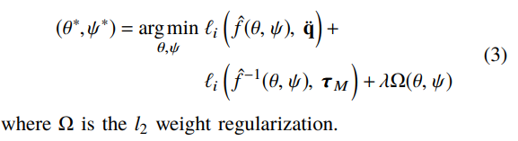
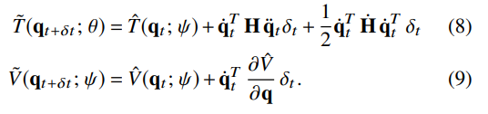
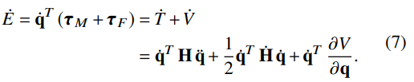
Loss function-
Adding energy conservation (Equation 7) and energy coherence (Equation 8 & Equation 9) to the optimization problem of Equation 3 yields the loss for DeLaN 4EC.

Slide 9
Control Law
Energy of the pendulum: Ep
Desired energy: E ∗
For systems with high friction an additional term to compensate the friction of the actuator can be added.
uE = controlled torque
For swing-up task the systems are first stabilized to the desired energy E ∗ of the balancing point using energy control and then balanced at the unstable equilibrium using a PD-controller.

Slide 10
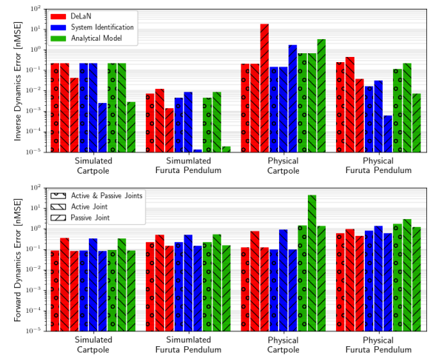
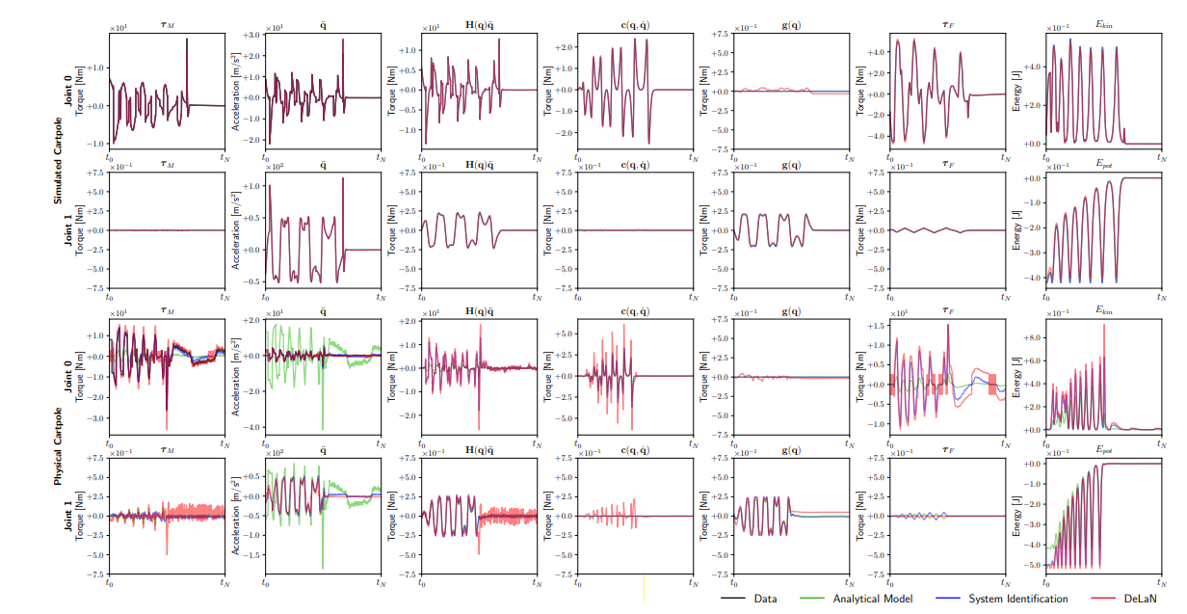
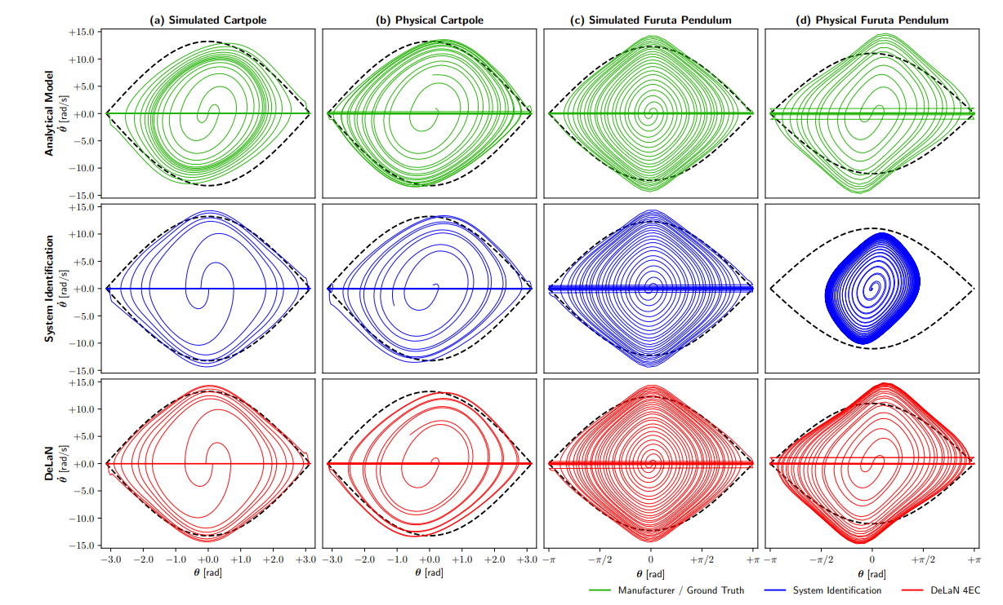
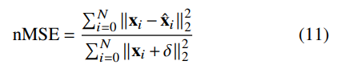
Result

Slide 11
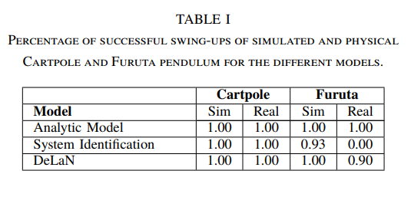
Result (offline control evaluation)
Only for the passive joint DeLaN performs slightly worse due to the noise.
For every other case it performed better or equivalent to system identification and analytical model.

Slide 12
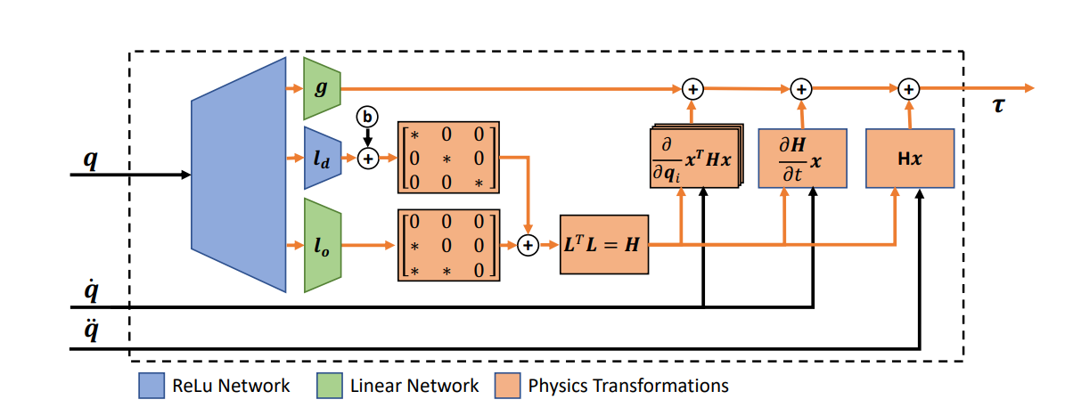
Deep Lagrangian Networks:
Using Physics as Model Prior for Deep Learning
Lutter, M., Ritter, C., Peters, J., Science, C., Universit, T., Hochschulstr, D., Networks, D. L., Mechanics, L., & Mechanics, L. (2019). Published as a conference paper at ICLR 2019. 1–17.

Slide 13
Forward model -
Inverse model-
H is mass matrix simplified as-
(L is lower triangular matrix)
.

Slide 14
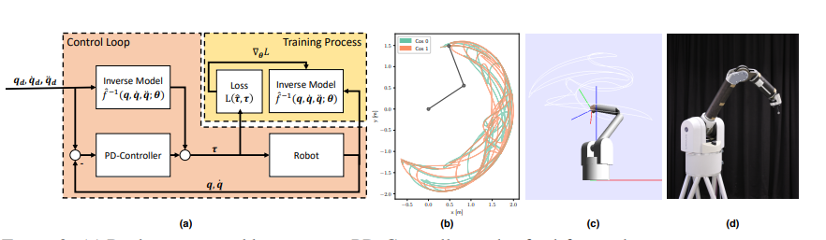
2R robot training
Tff is returned from the network
Control Law implemented (Torque values are updated at 200 Hz frequency)

Slide 15
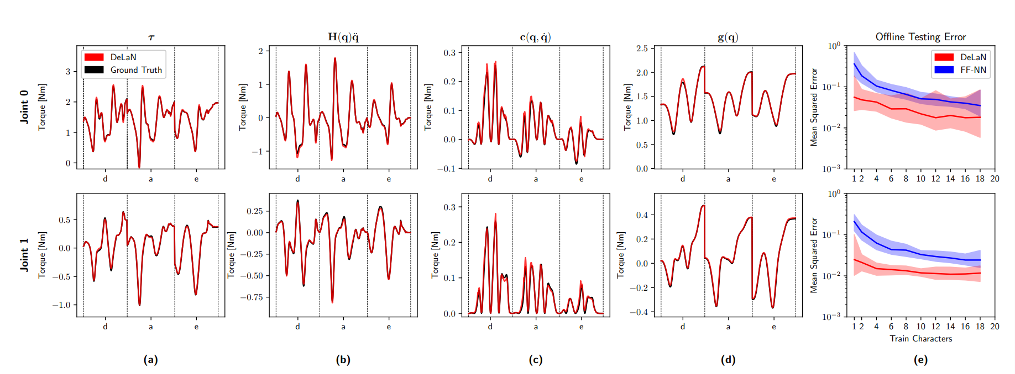
Testing result

Slide 16
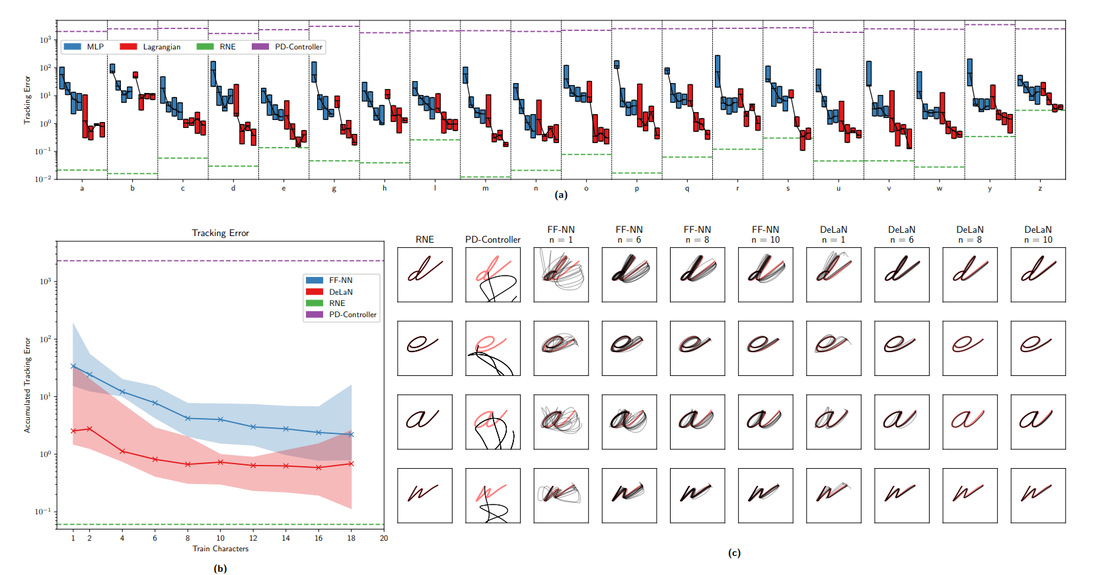
Testing for various n_dof

Slide 17
Lagrangian Neural Networks
Cranmer, M., Greydanus, S., Hoyer, S., Battaglia, P., & Spergel, D. (n.d.). Agrangian eural etworks. 1–9.

Slide 18
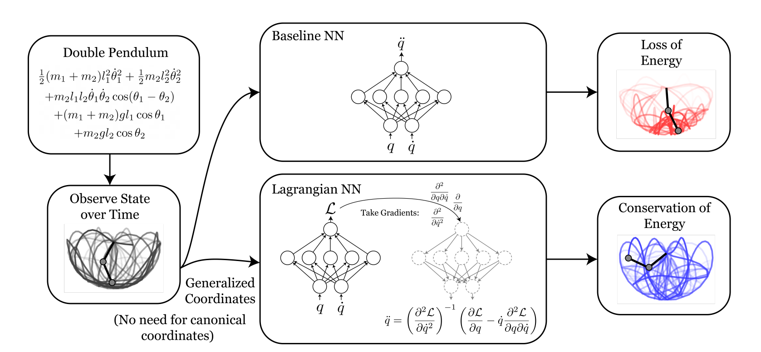
Network Overview
Predicting Lagrangian through neural network and then feeding this to the Euler Lagrangian equation to get q double dot or required torques

Slide 19
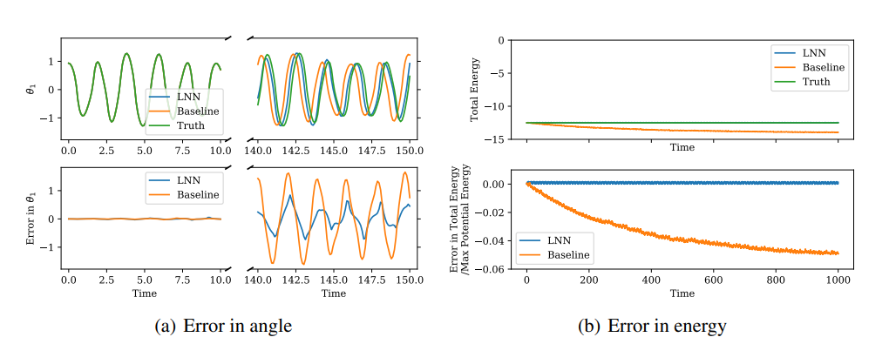
Double Pendulum
LNN almost exactly conserved the true energy over time, whereas the baseline did not. Averaging over 40 random initial conditions with 100 time steps each, the mean energy discrepancy between the true total energy and predicted was 8% and 0.4% of the max potential energy for the baseline and LNN models.

Slide 20
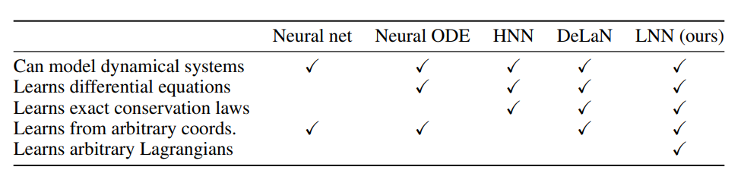
Comparison with DeLaN
DeLaN. A closely related previous work is “Deep Lagrangian Networks”, or DeLaN (Lutter et al., 2019), in which the authors show how to learn specific types of Lagrangian systems. They assume that the kinetic energy is an inner product of the velocity: T = ˙q TMq˙, where M is a q-dependent positive definite matrix. This approach works well for rigid body dynamics, which includes many systems encountered in robotics. However, many systems do not have this kinetic energy, including, for example, a charged particle in a magnetic field, and a fast-moving object in special relativity. Other Lagrangian-based approaches include Gupta et al. (2019); Qin (2019).

Slide 21
Michael Lutter repository
https://github.com/milutter/deep_lagrangian_networks

Slide 22
Libraries required
Numpy
Matplotlib
Torch
Jax
Dill
Haiku
Warnings
Time

Slide 23
Classes and functions
Replay memory-
load_dataset- load data file for training and testing
LowTri - input- n (size of L = nxn) l (l = elements in L) ; Returns L n= n_dof
(mass matrix)
Langrangian Layer - input- n_dof, q, qd (q dot), qdd (q double dot), activation, input size
Deep Langrangian - input- n_dof, **kwargs (hyperparameters), q, qd (q dot), qdd (q double dot)

Slide 24
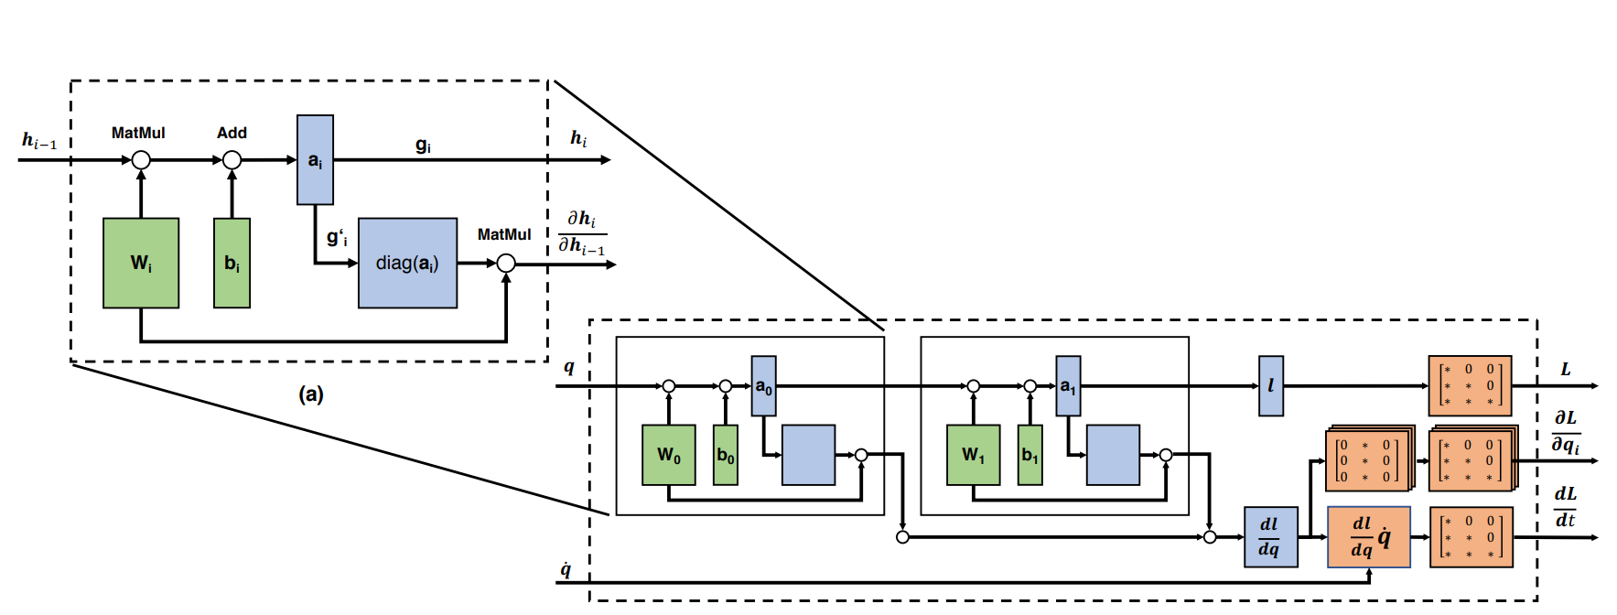

Slide 25
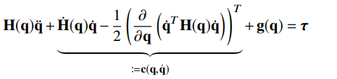
Functions in Deep Lagrangian (Class)
_init_ - Parameters which are n_width, n_depth, b_init, b_diag_init, w_init, g_hidden, g_hidden, p_sparse, diagonal_epsilon
_dyn_model (q, q_dot, q_double_dot) - Through 3 different layers computes Mass matrix (2 layers used) and g (= derivation of potential energy) and uses these in Euler-Lagrangian equations. returns- Tau predicted, Mass matrix, Coriolis and centrifugal forces, Mg, Kinetic energy, potential energy, Kinetic energy derivative, potential energy derivative.
Forward (q, q_dot, q_double_dot) - returns- Tau predicted, derivative of (K.E. + P.E.)
For_dyn (q, q_dot, q_double_dot)- returns- Tau predicted
Inv_dyn (q, q_dot, q_double_dot)- returns- q double dot predicted
Energy (q, q_dot, q_double_dot)- returns- K.E. + P.E.
Energy_dot (q, q_dot, q_double_dot)- returns- derivative of (K.E. + P.E.)

Slide 26
Training
N_dof = 2
Training data- train_labels, train_qp, train_qv, train_qa, train_p, train_pd, train_tau
Hyper = {.....} (define hyperparameters for the neural network
Delan_model = DeepLagrangianNetwork(n_dof, **hyper)
optimizer= Adam optimizer
Generate replay memory
Training Loop-

Slide 27
Training Loop
Get Tau predicted and dE/dt predicted from delan_model(q, q_dot, q_double_dot)
E-L differential loss = mean.mse(Tau predicted, Train_tau)
Power conservation loss = mean.mse( dE/dt predicted, dE/dt)
[ dE/dt = transpose(q_dot) * train_tau ]
Total loss= E-L differential loss + Power conservation loss
Backpropagate and optimize the network
Update the predicted data

Slide 28
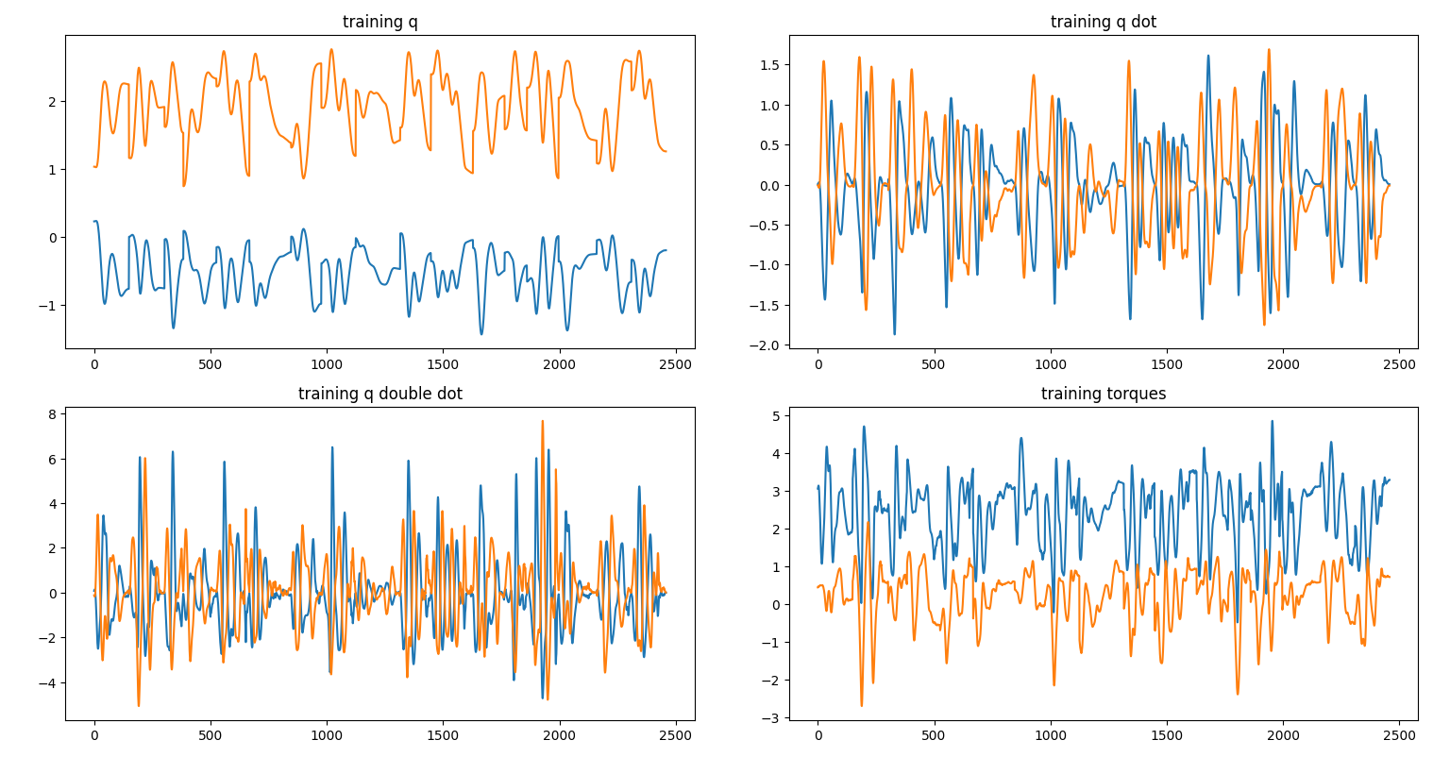

Slide 29
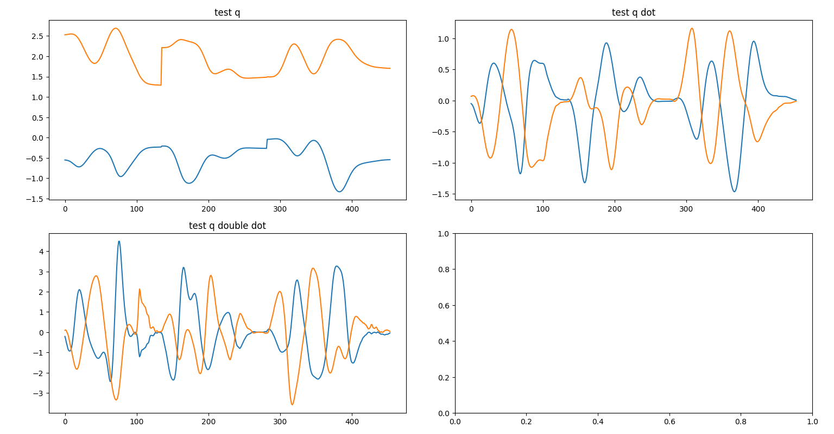
Testing
Testing data - qp, qv, qa, p, pd, tau, m (mass torque), c (coriolis torque), g (gravity torque)

Slide 30
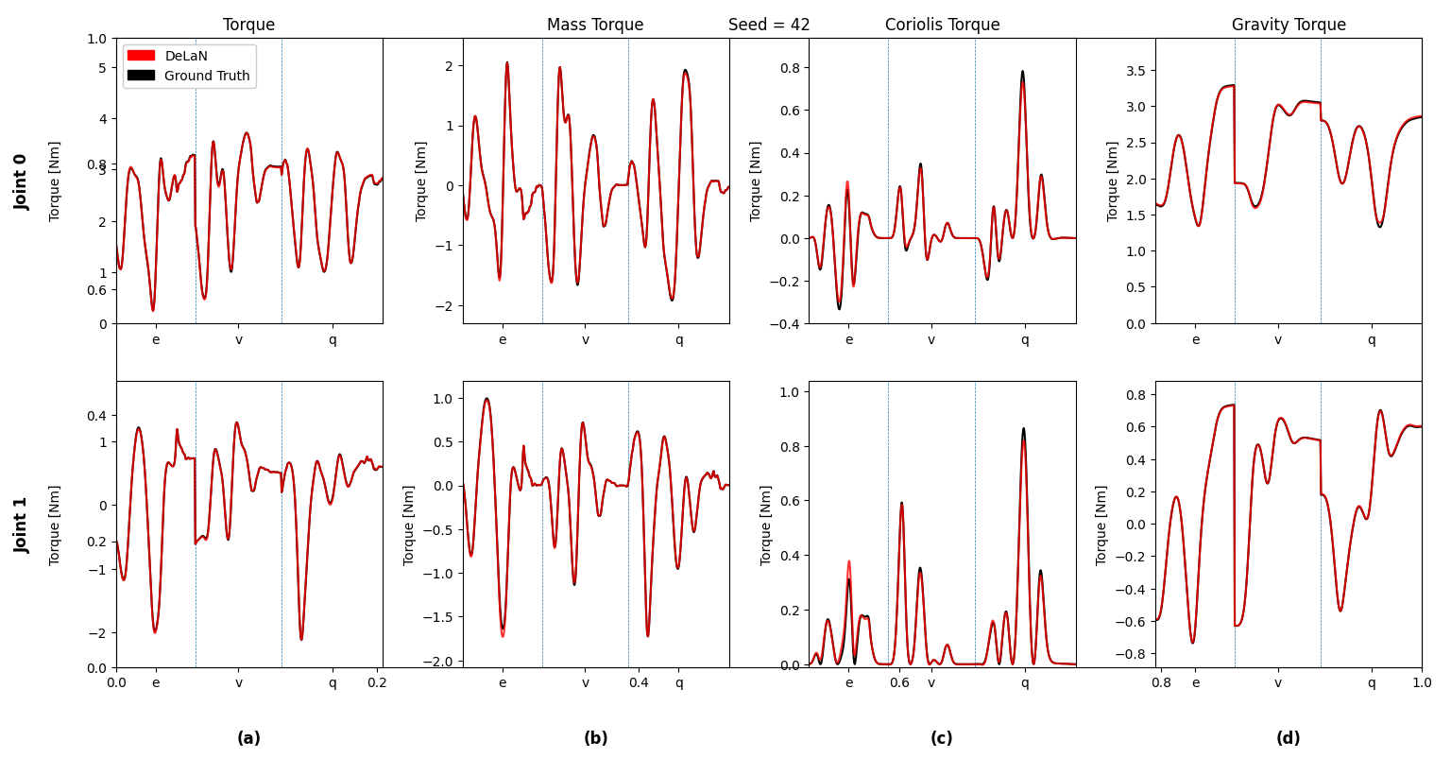
Results from test data

Slide 31
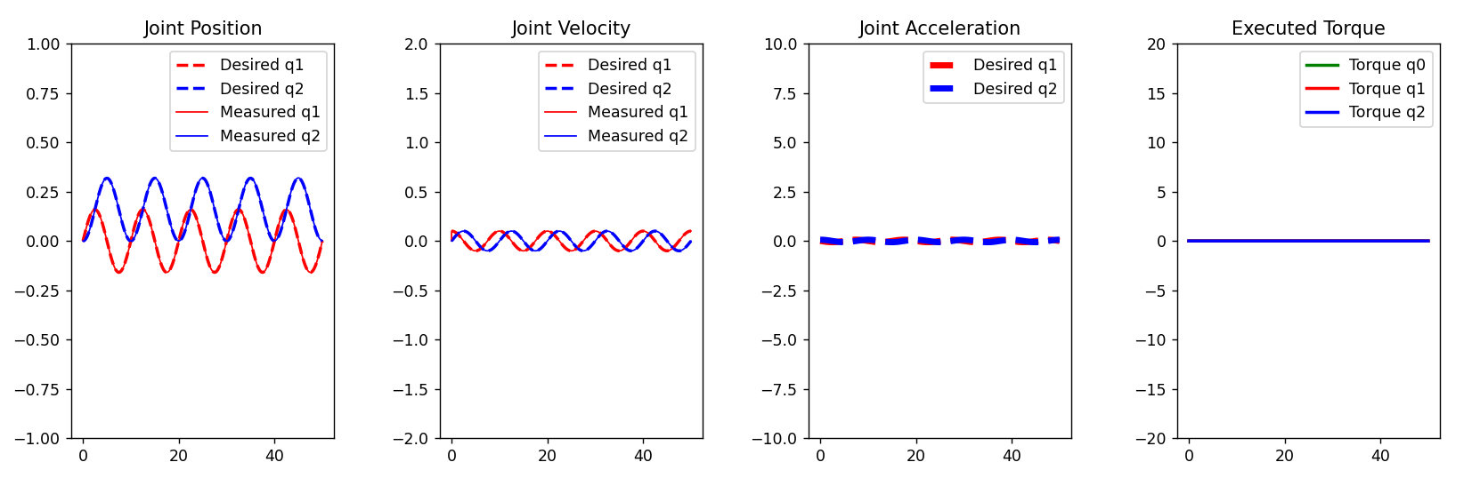
Training DeLaN for single leg
Built-in python function (calculateInverseDynamics) was used to get training and testing data for torque values.

Slide 32
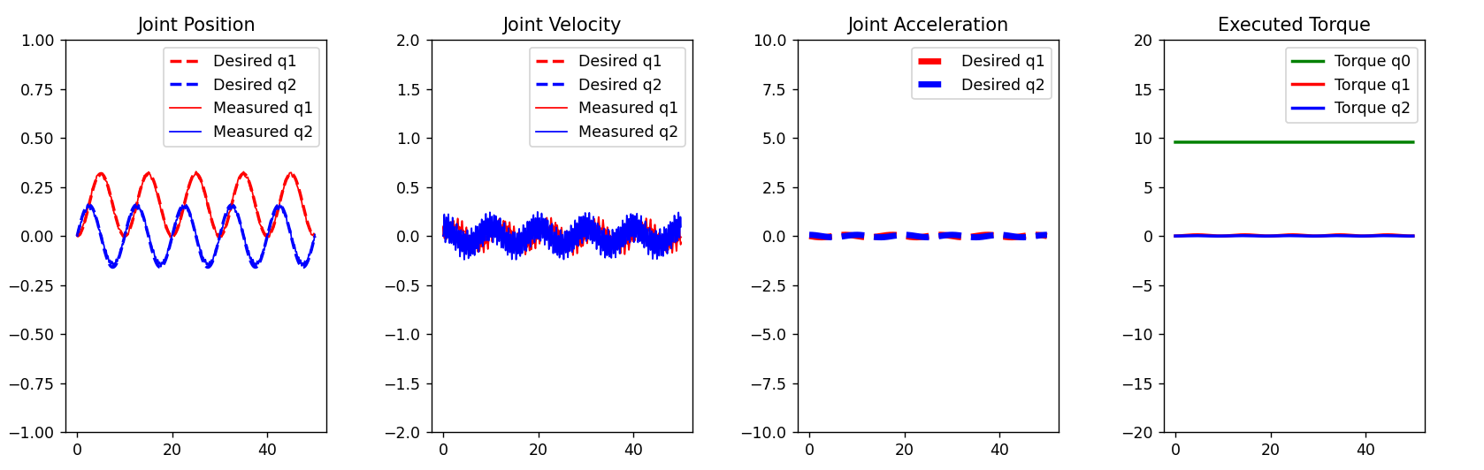
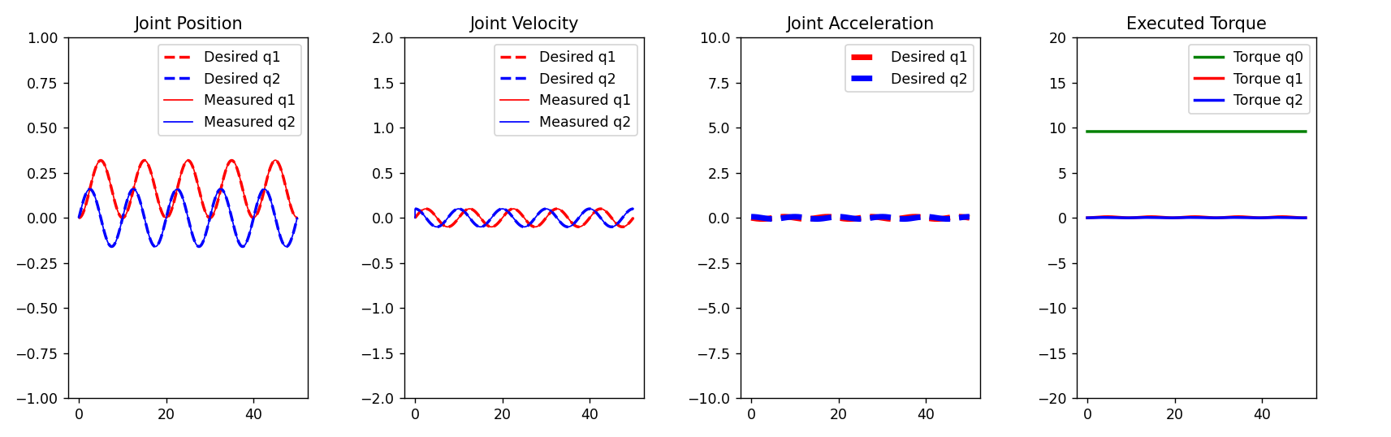
Testing results
DeLan torque
Simulation
Analytical torque
simulation

Slide 33
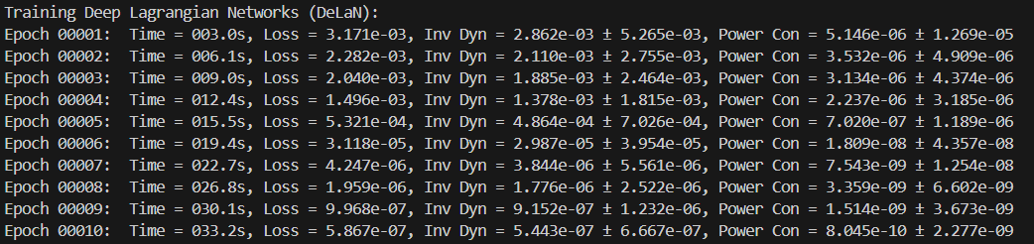
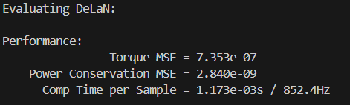
DeLaN performance

Slide 34
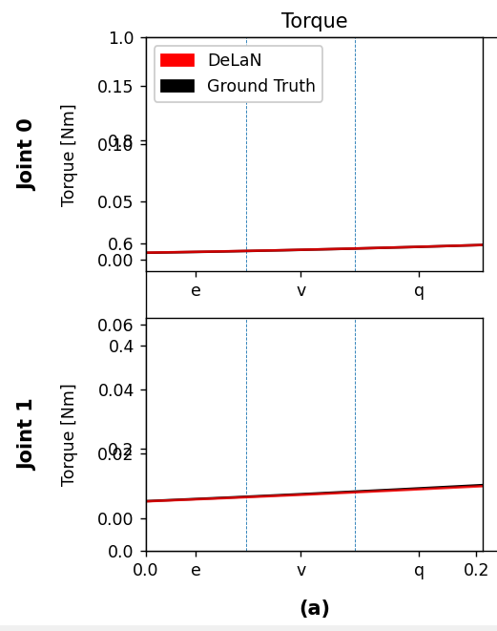
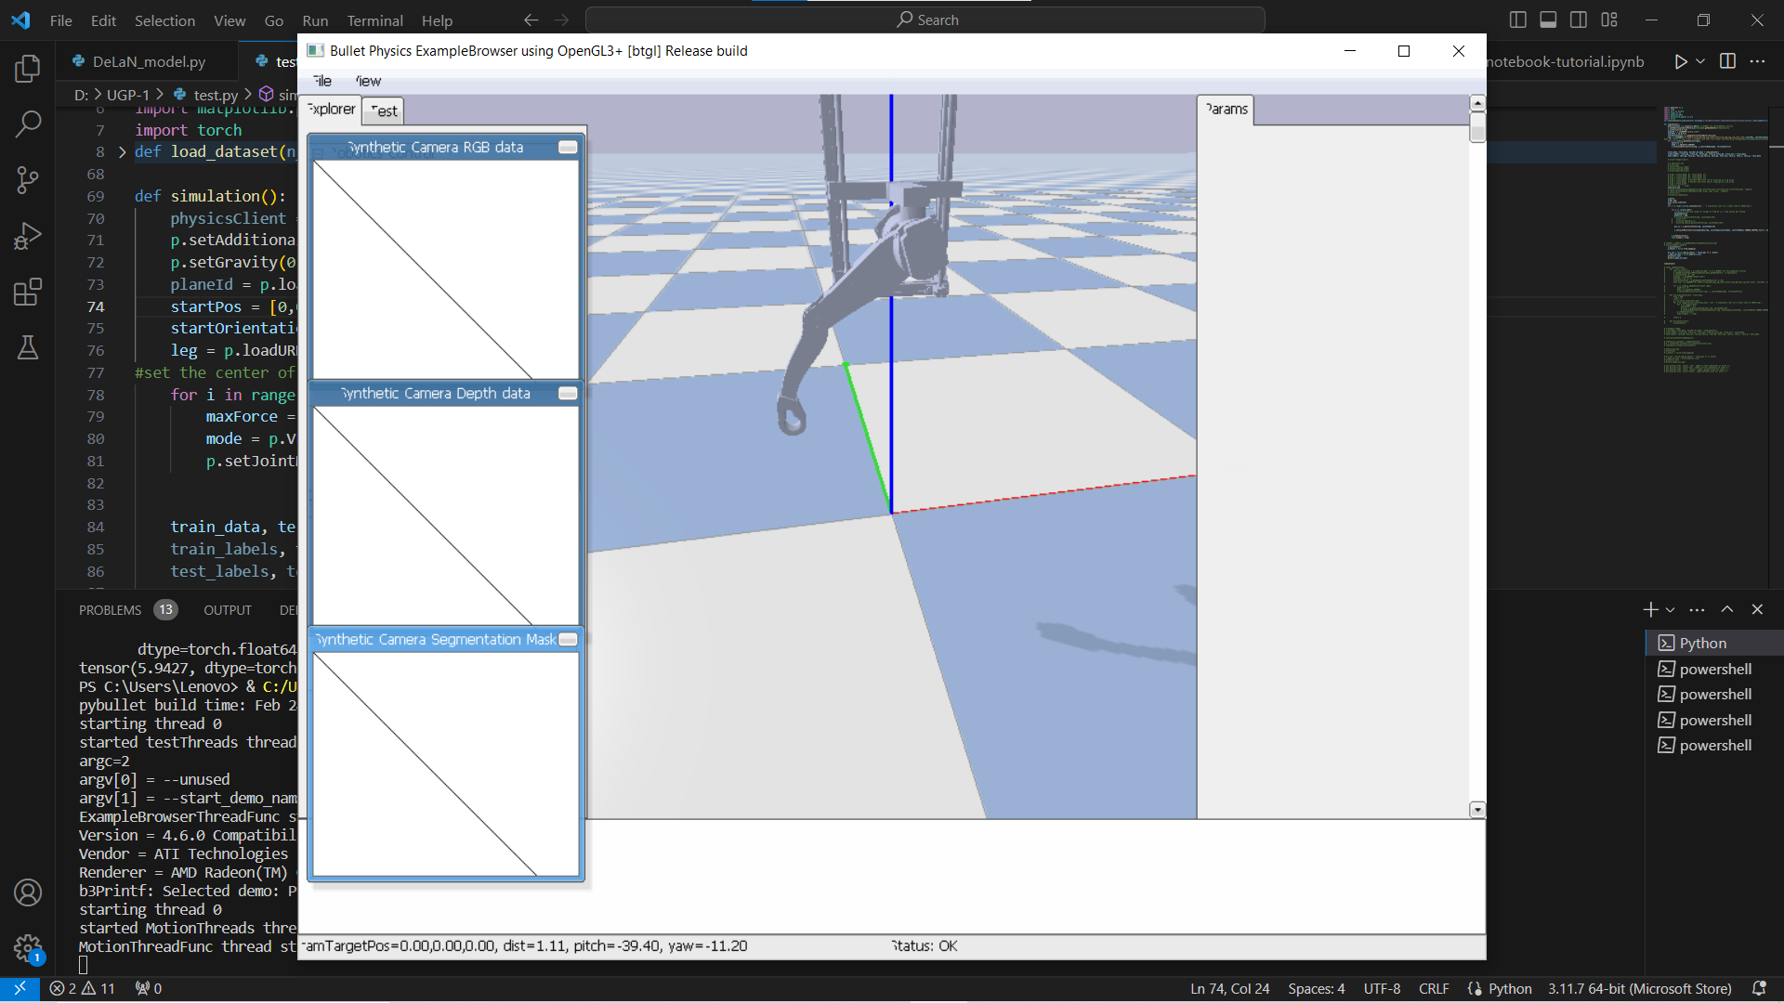
Torque validation and Pybullet simulation

Slide 35
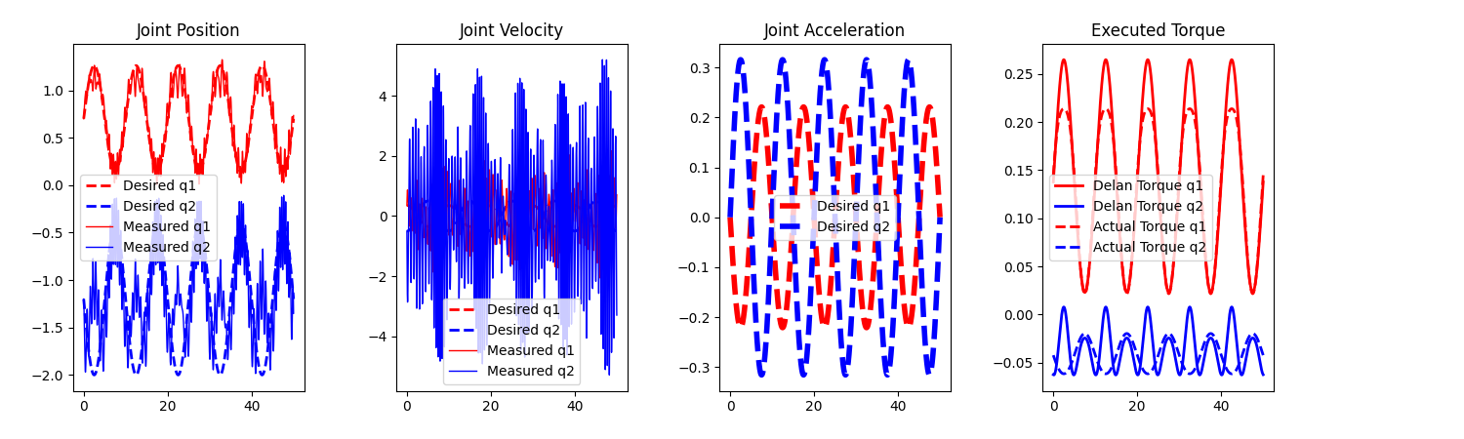
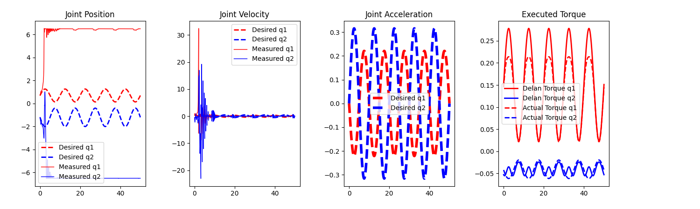
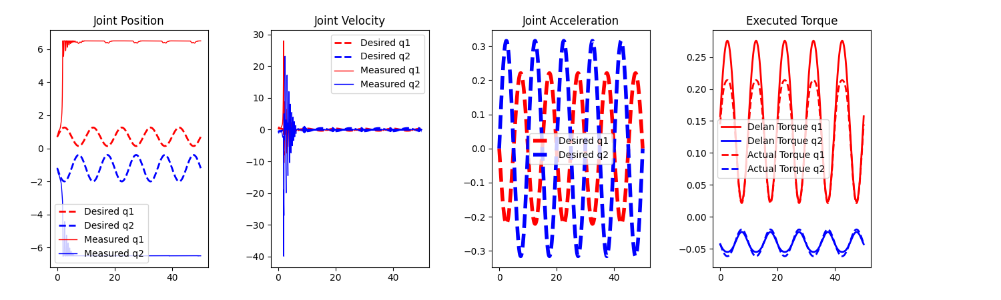
Increasing
Epochs
10 epochs
100 epochs
10000 epochs

Slide 36
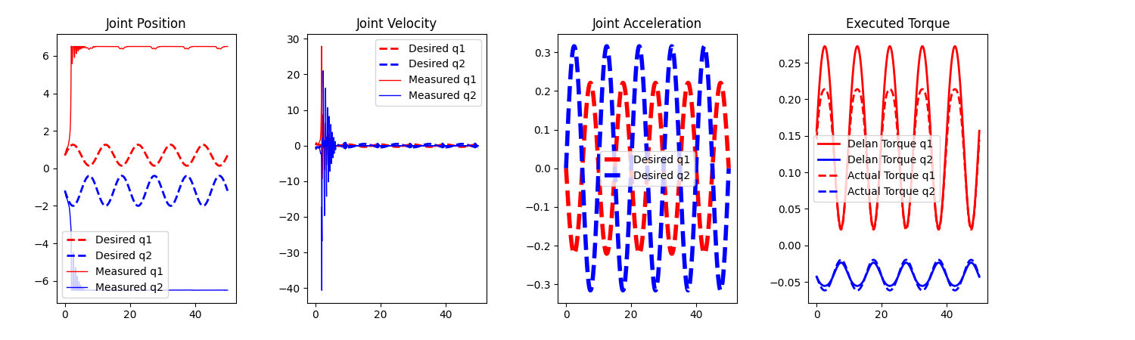
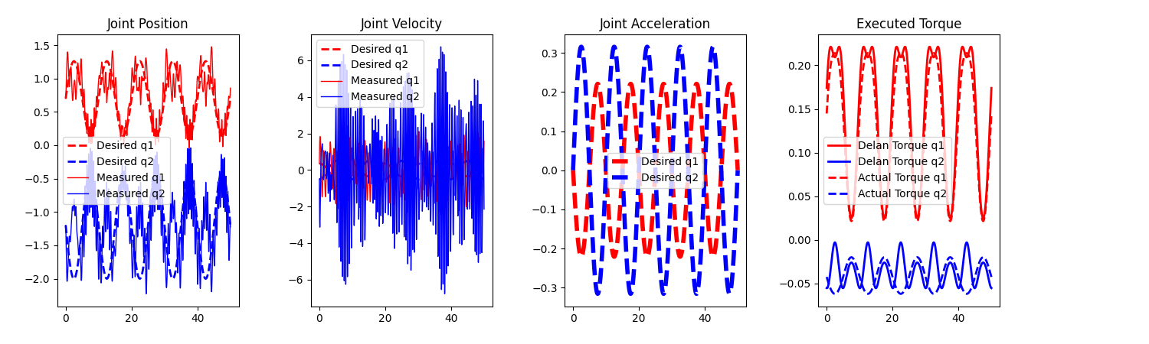
Changing learning
rates
5 x 10^(-03)
5 x 10^(-04)
(default in code)
5 x 10^(-05)
(1000 epochs)

Slide 37
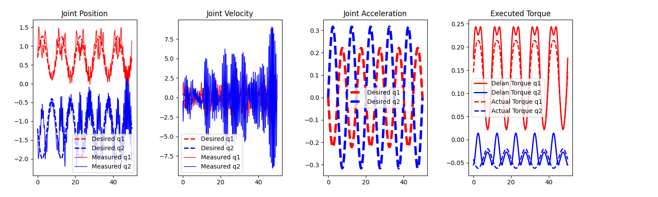
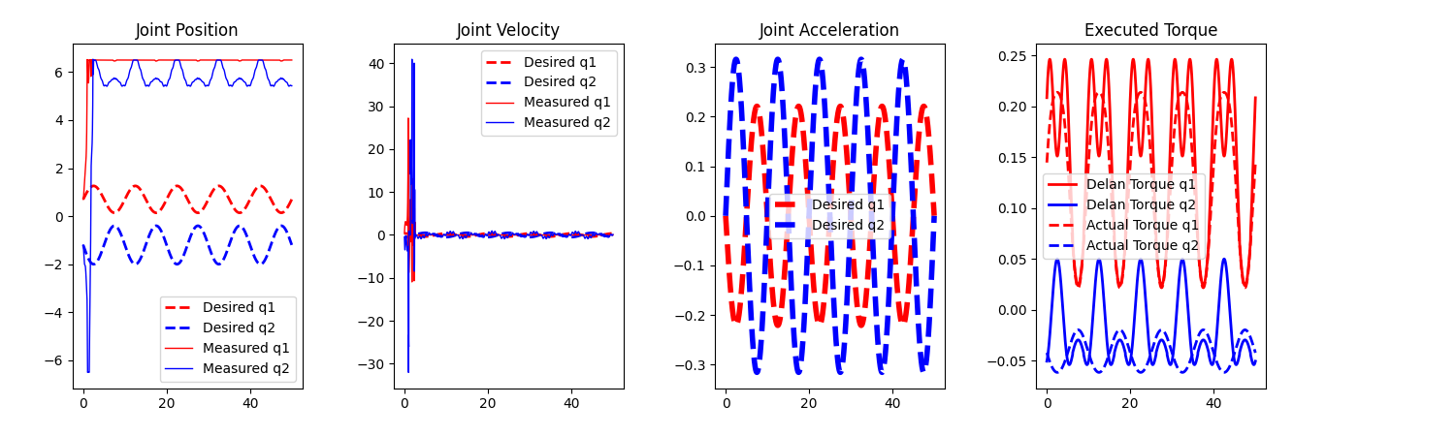
Learning rate (10,000 epochs)
5 x 10^(-05)
5 x 10^(-06)

Slide 38
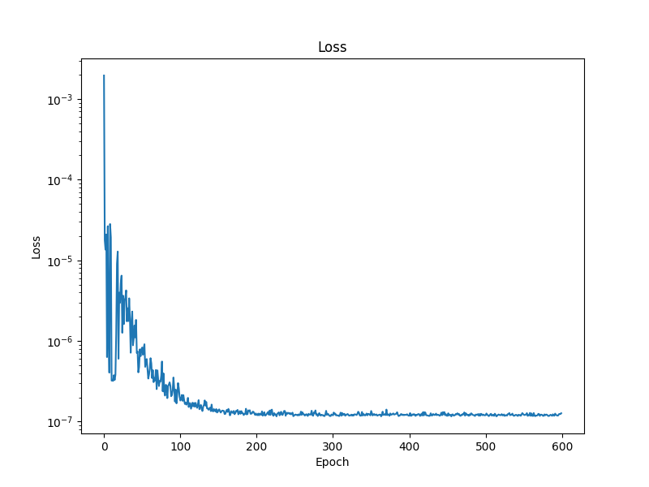
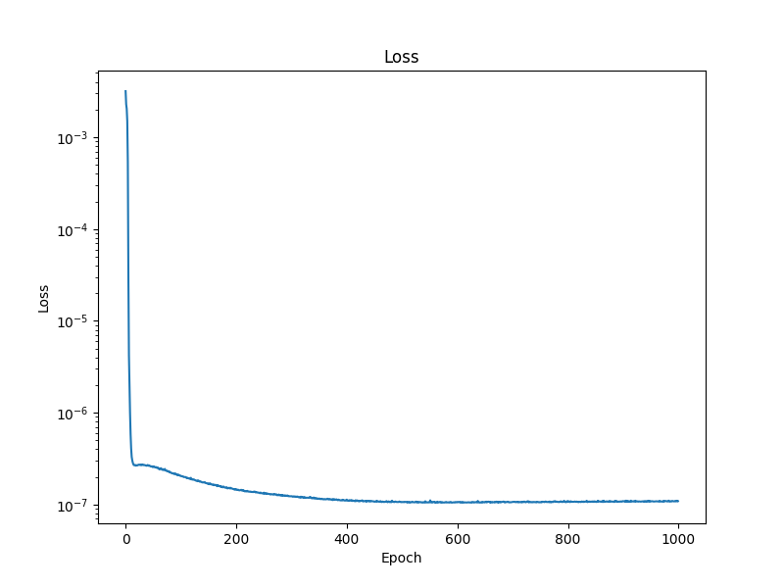
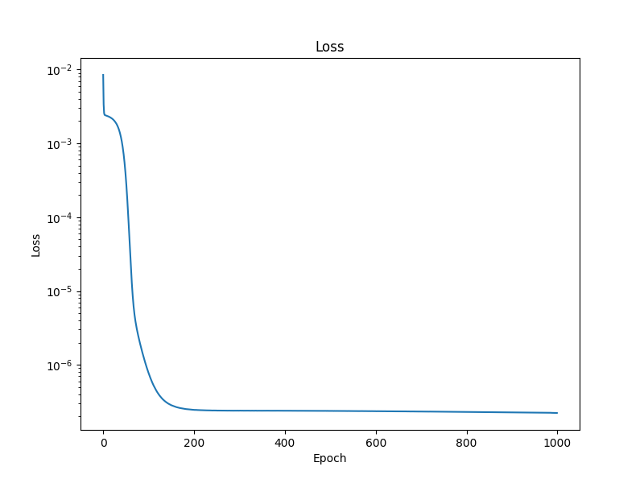
Training Loss
Learning rate = 5 x 10^(-03) Learning rate = 5 x 10^(-04) Learning rate = 5 x 10^(-05)

Slide 39
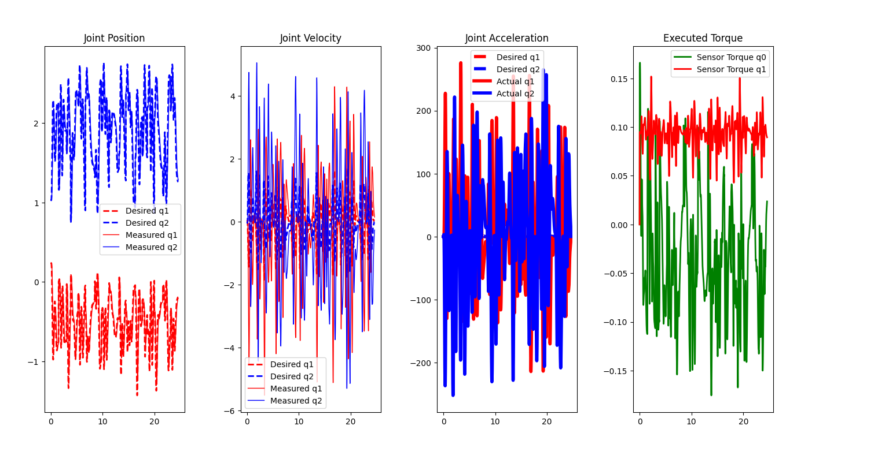
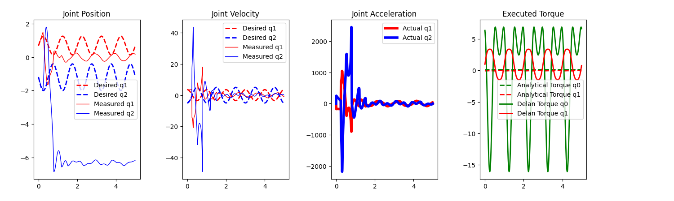
Arbitrary data
Training-
(1000 epochs)
Testing-

Slide 40

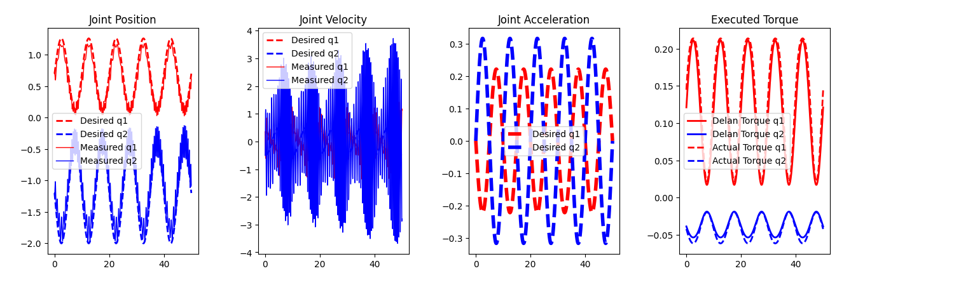
Performance after multiplying by a factor
Through Inverse Dynamics Through DeLaN
Tracking error p = 0.1276
Tracking error v = 0.6964

Slide 41
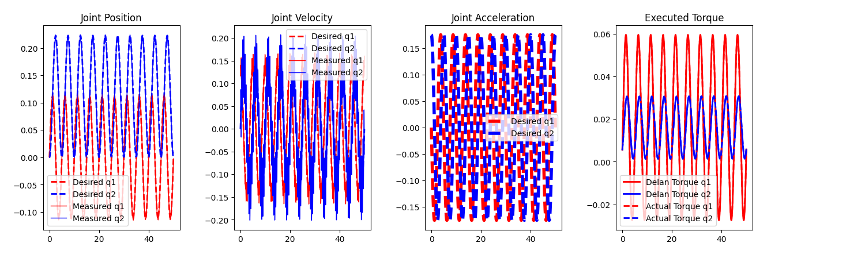
Change in frequency between train and test data
Amplitude = 0.7 x A [A = Amplitude used in training data = 1/(2pi) = 0.16 rad]
Frequency = 0.2 Hz [Frequency used in training data = 0.1 Hz]
Tracking error p = 0.00277 [Mean Absolute Error of joint position]
Tracking error v = 0.02915 [Mean Absolute Error of joint velocity]

Slide 42
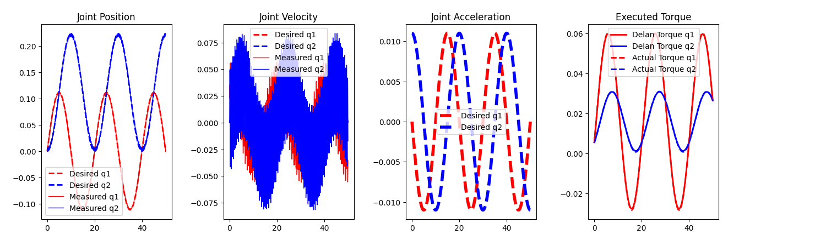
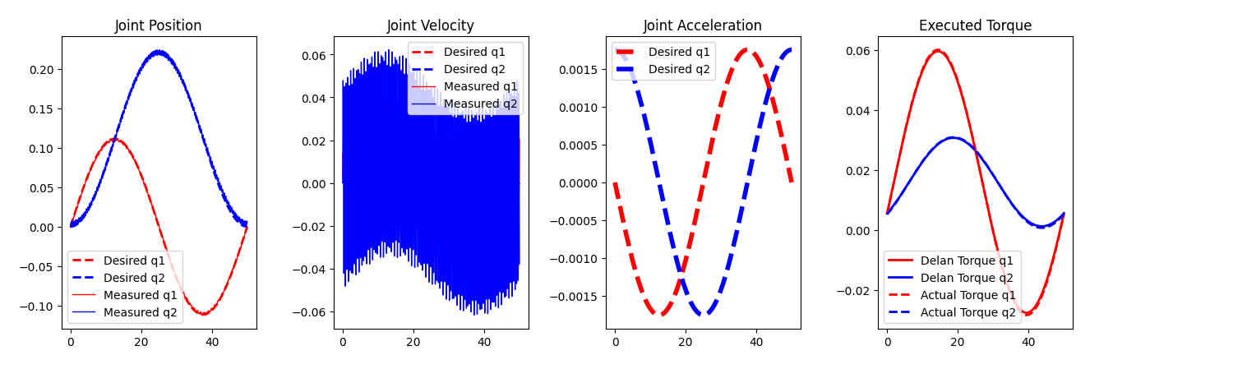
Amplitude = 0.7 x A
Frequency = 0.05
Tracking error p = 0.00168
Tracking error v = 0.0198
Amplitude = 0.7 x A
Frequency = 0.02
Tracking error = 0.00176
Tracking error v = 0.01965

Slide 43
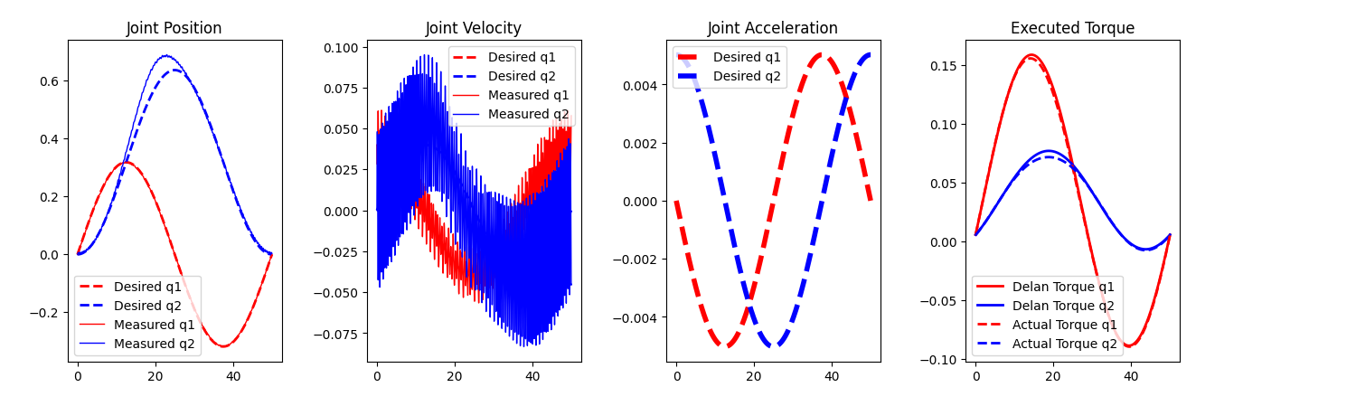
Increasing Amplitude
Amplitude = 2 x A Tracking error p = 0.0166
Frequency = 0.02 Tracking error v = 0.0194

Slide 44

Decreasing Amplitude
Amplitude = 0.05 x A Tracking error p = 0.0209
Frequency = 0.1 Tracking error v = 0.0198

Slide 45

Comparison between Mass Matrix

Slide 46
Conclusion
Torque can only be predicted for joint angle for which it is trained
Hence Amplitude and offset should be inside training data
Prediction is independent of frequency (for a range of frequency)
It cannot learn PD control torque

